Slide 1

Doing Survey Research in Contemporary China
Donald J. Treiman
March 2009

Slide 2
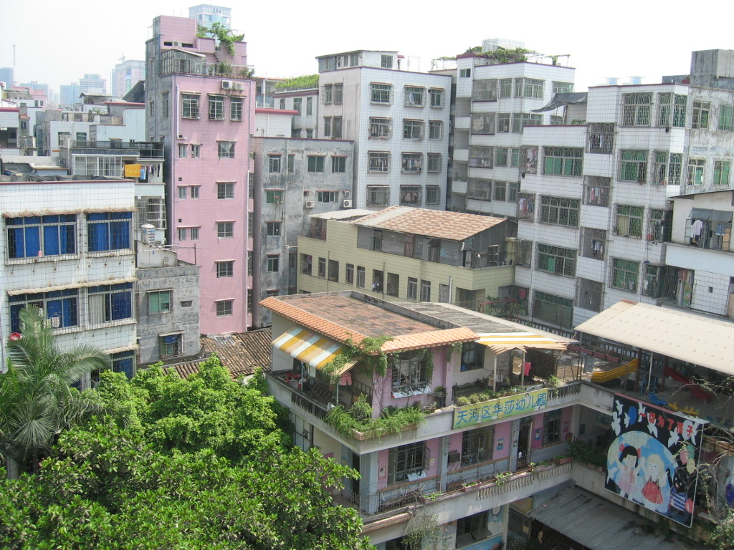

Slide 3
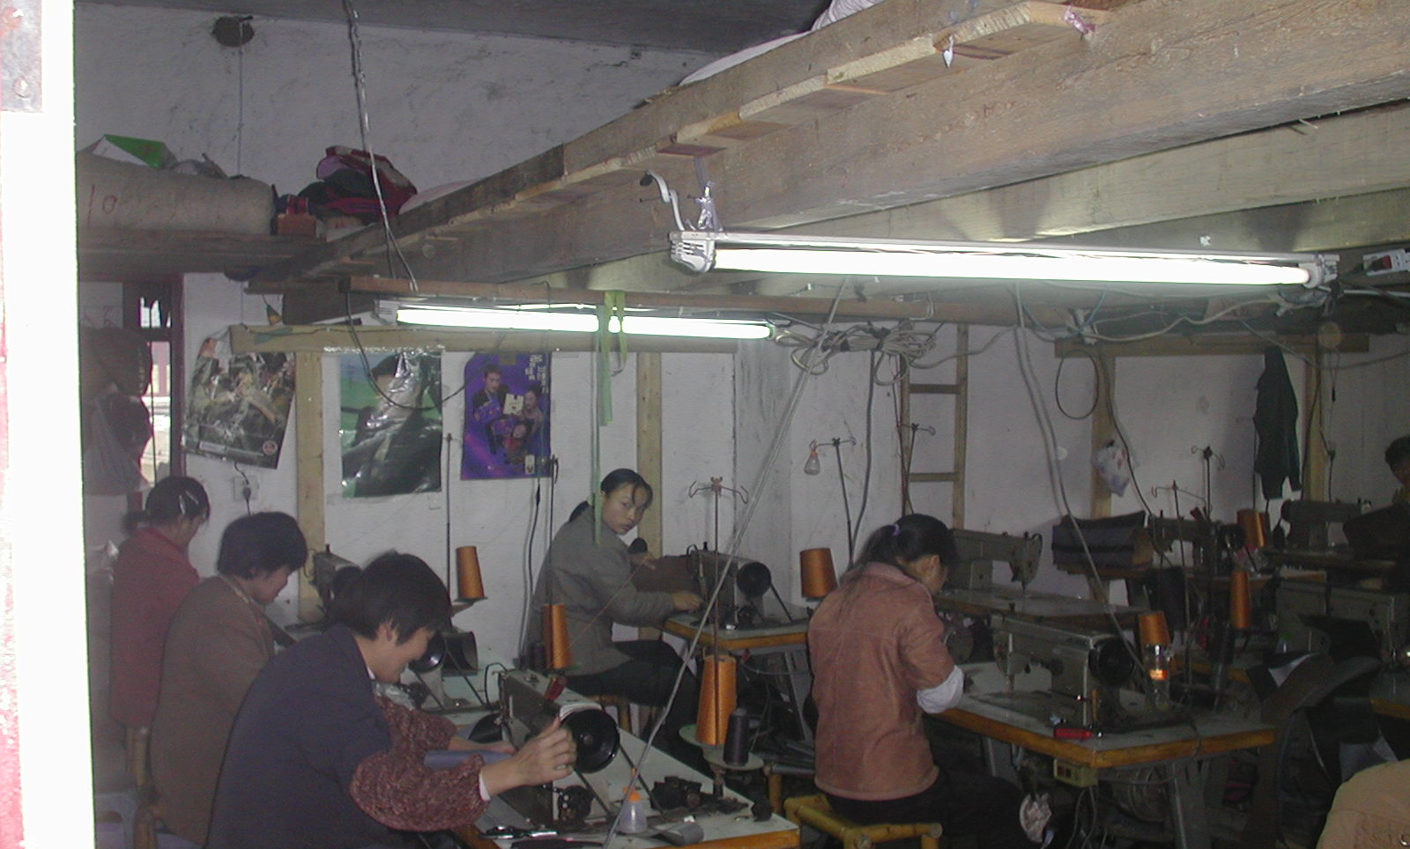
Migrant workers sleep on pallets in loft above
26


Clothing sweatshop
Morrison Institute, Stanford
Morrison Institute, Stanford
Morrison Institute, Stanford
Morrison Institute, Stanford
Morrison Institute, Stanford
Morrison Institute, Stanford
1/7/2009
1/7/2009
1/7/2009
1/7/2009

Slide 4
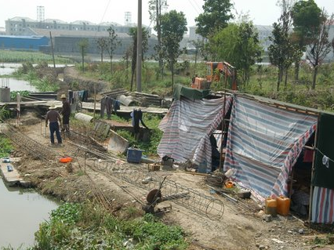

Slide 5
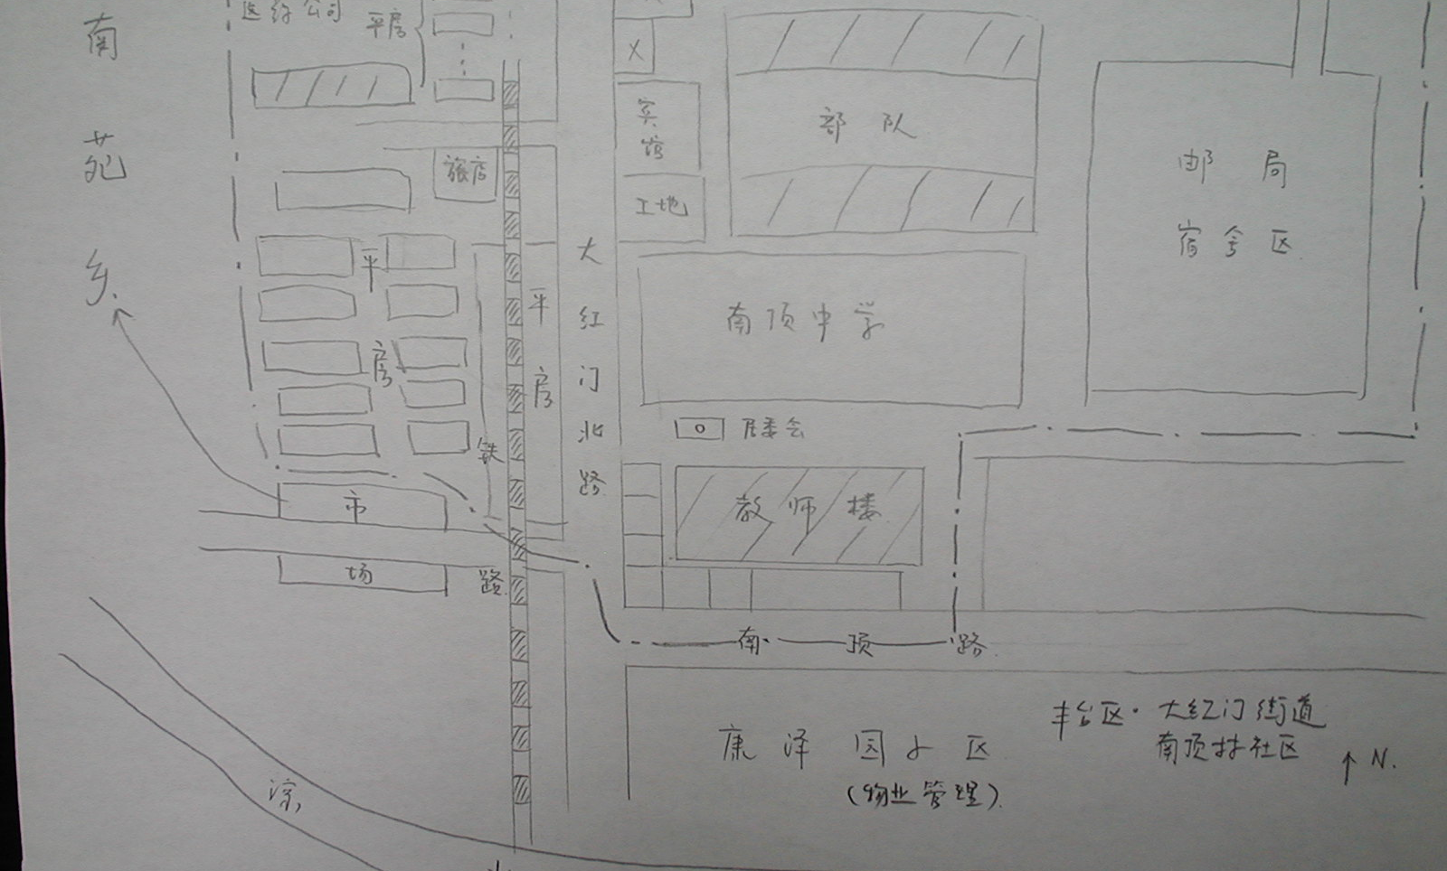
Enumeration sketch map
34


Delineates medical supplies company, houses, hotel, shops and restaurants along the street, a construction site, middle school, post office danwei, and other important details
Morrison Institute, Stanford
Morrison Institute, Stanford
Morrison Institute, Stanford
Morrison Institute, Stanford
Morrison Institute, Stanford
Morrison Institute, Stanford
1/7/2009
1/7/2009
1/7/2009
1/7/2009

Slide 6
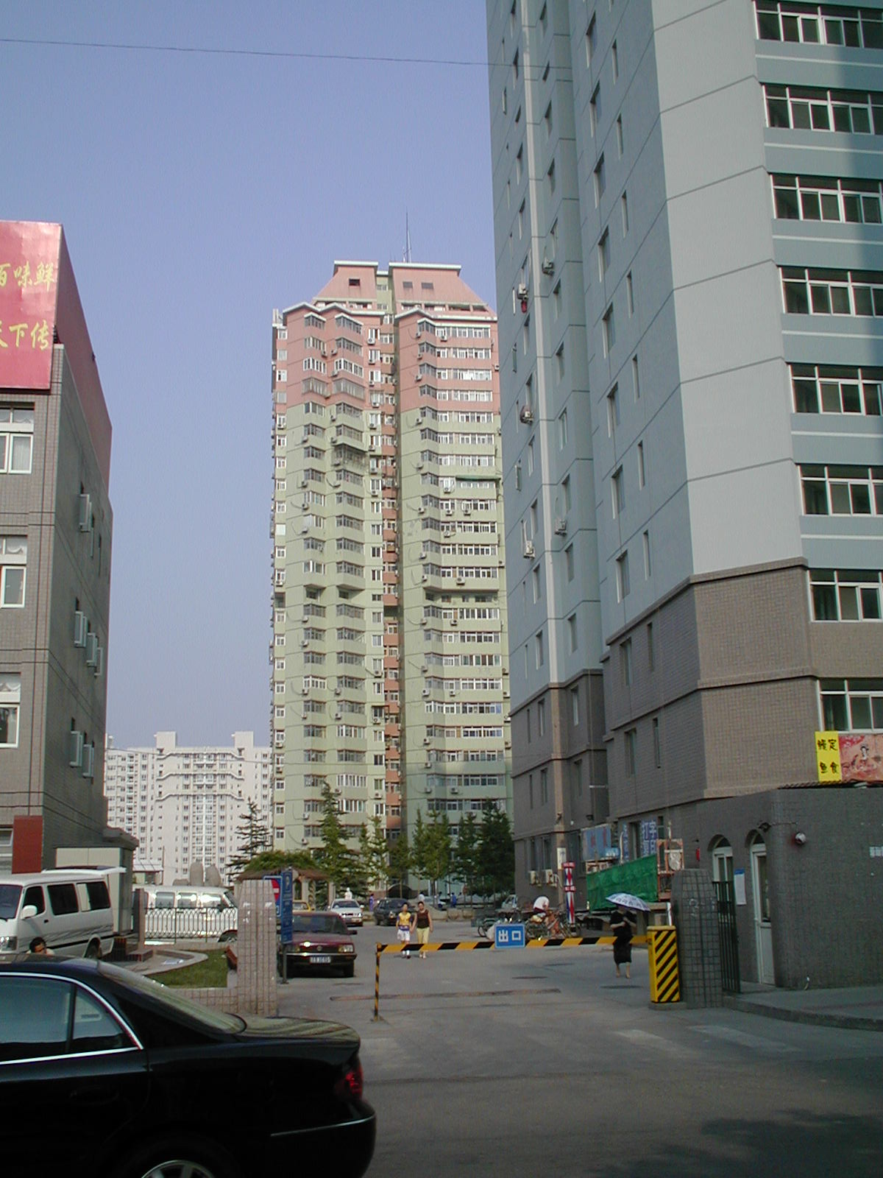


Notes:
1/6/2009
‹#›
1/6/2009
‹#›
1/6/2009
‹#›
Beijing monsters. It is daunting even to contemplate an attempt at enumeration.
1/6/2009
‹#›

Slide 7
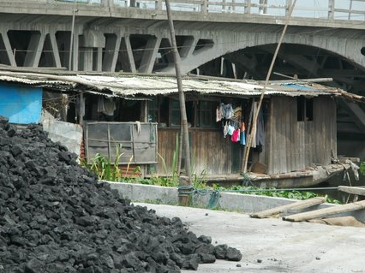
Boat dwelling near Suzhou

Slide 8
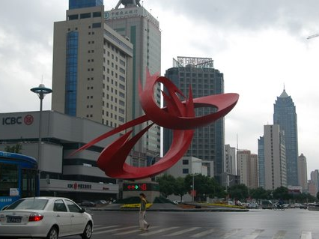
Modern Suzhou

Slide 9
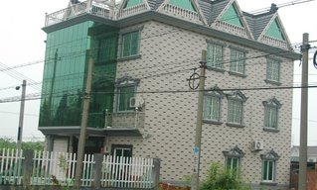
Peasant investment
43


Peasant house near Hangzhou. Seen often enough not to be surprising
Morrison Institute, Stanford
Morrison Institute, Stanford
Morrison Institute, Stanford
Morrison Institute, Stanford
Morrison Institute, Stanford
Morrison Institute, Stanford
1/7/2009
1/7/2009
1/7/2009
1/7/2009

Slide 10
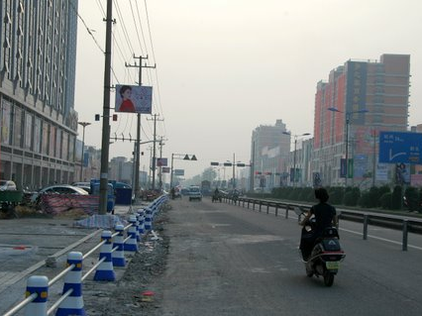
The meaning of “rural” and “village” is elastic

This is a xiang so large and dense that it would need to be gridded for enumeration in a survey
Morrison Institute, Stanford
Morrison Institute, Stanford
Morrison Institute, Stanford
1/7/2009
1/7/2009
1/7/2009

Slide 11
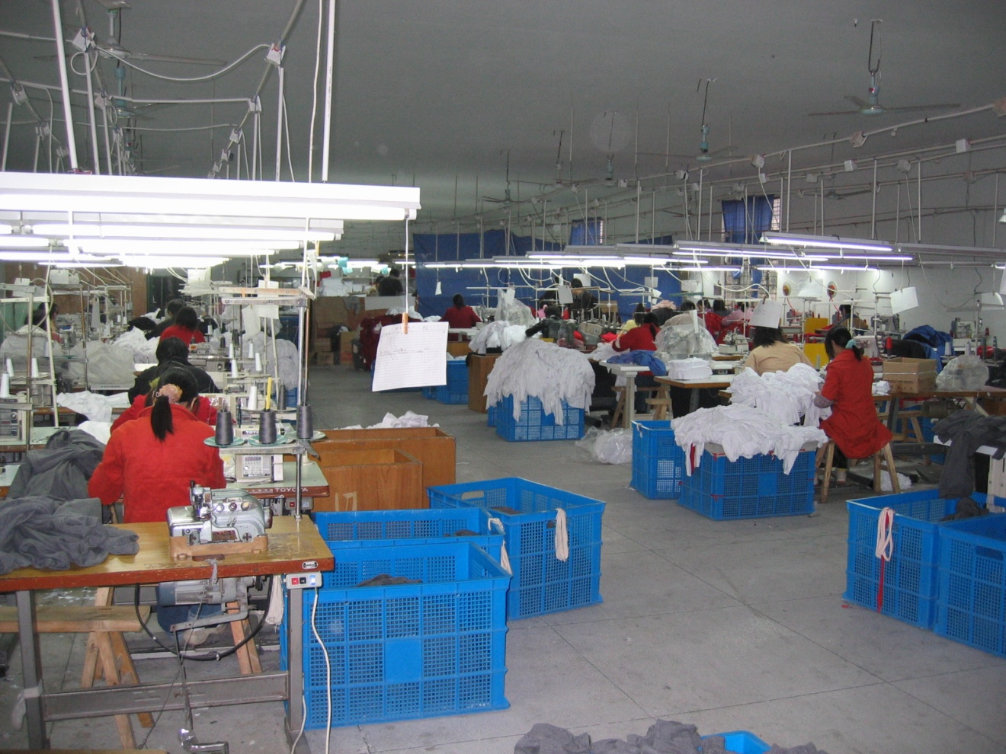
Small factory

Slide 12
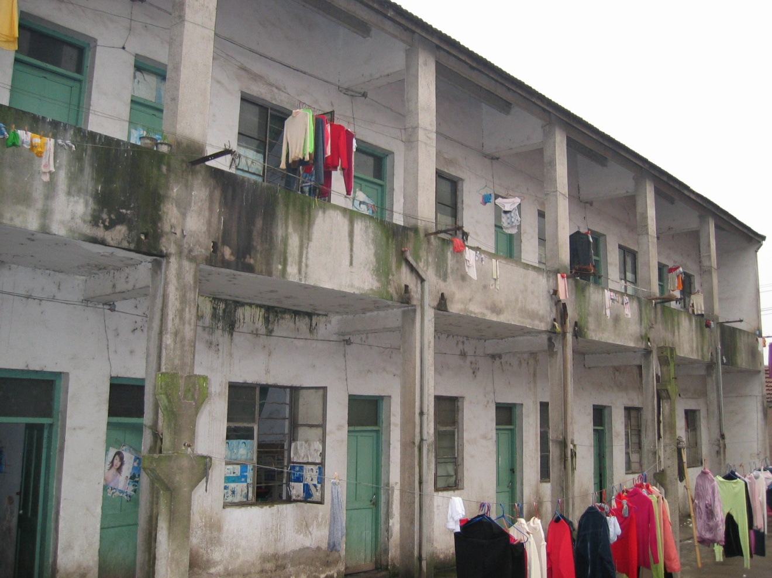
Dormitory for factory

Slide 13
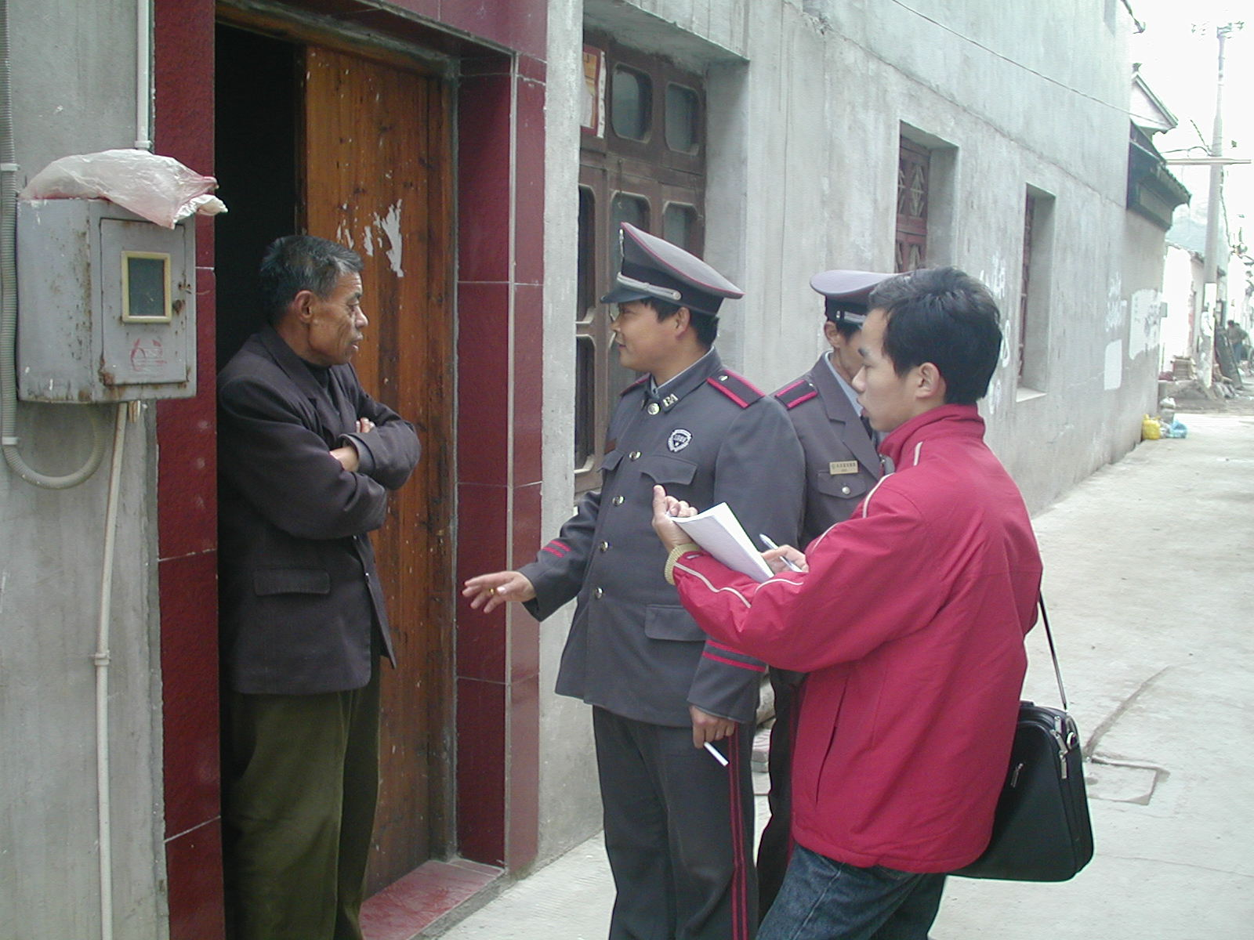
The cooperation of local officials often helps.

Slide 14
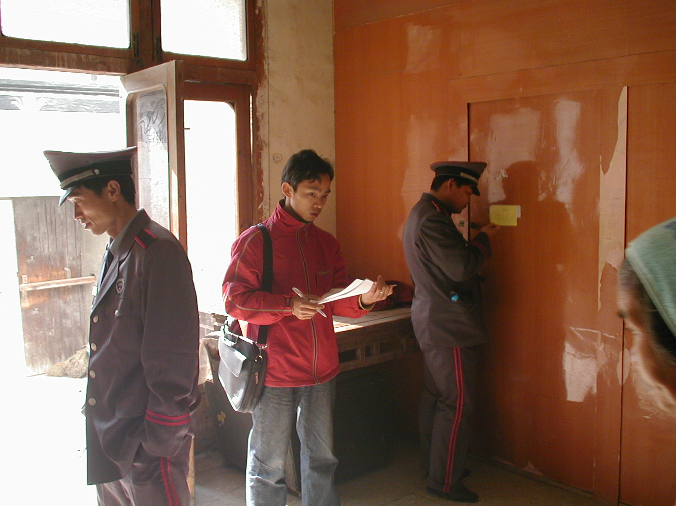

Slide 15
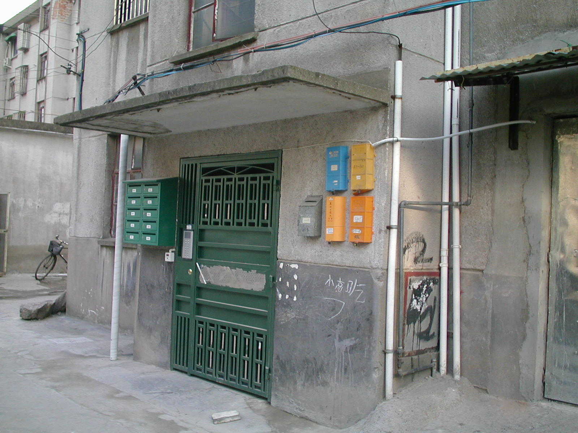
A downscale apartment block, difficult to get into.

Slide 16
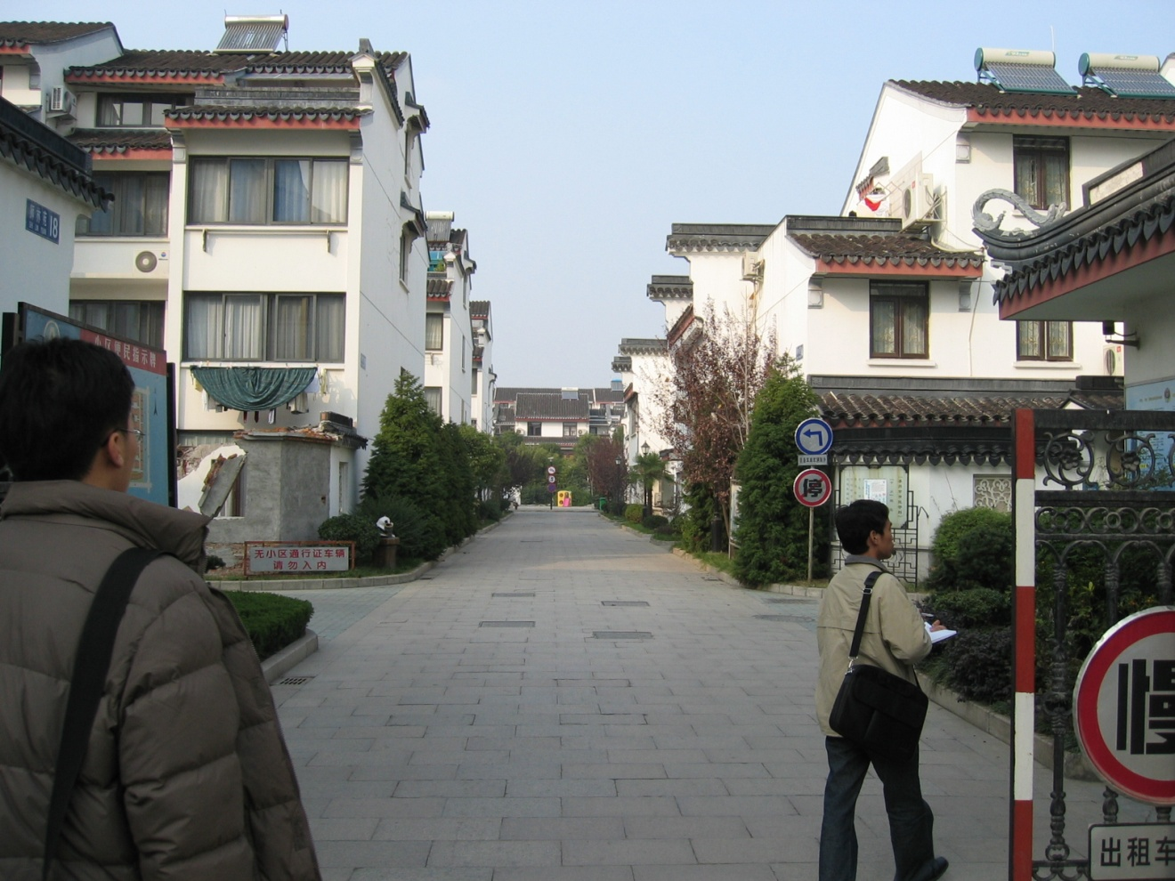
Upscale gated community

Slide 17
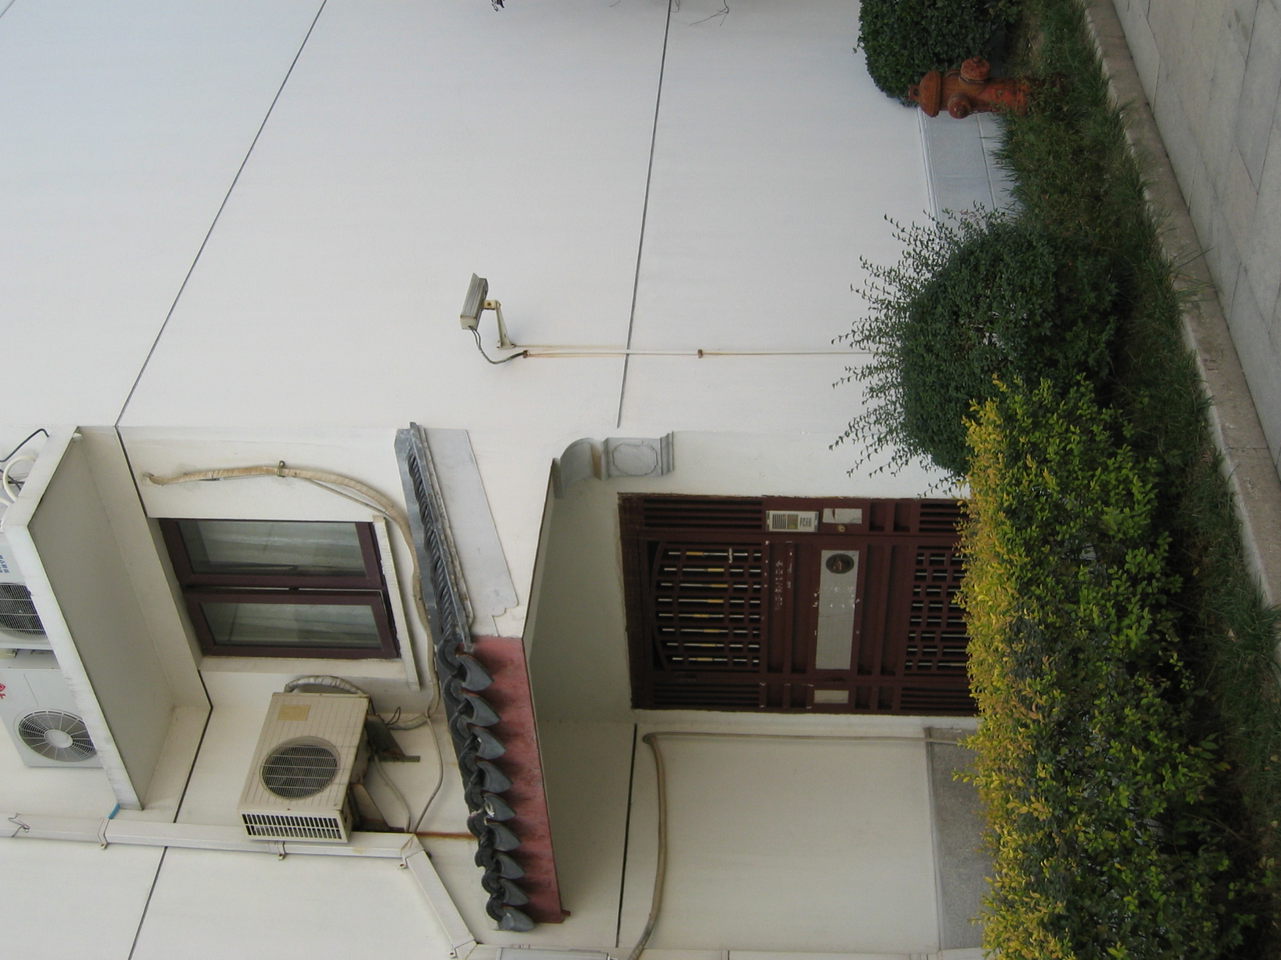
Note the TV camera

Slide 18
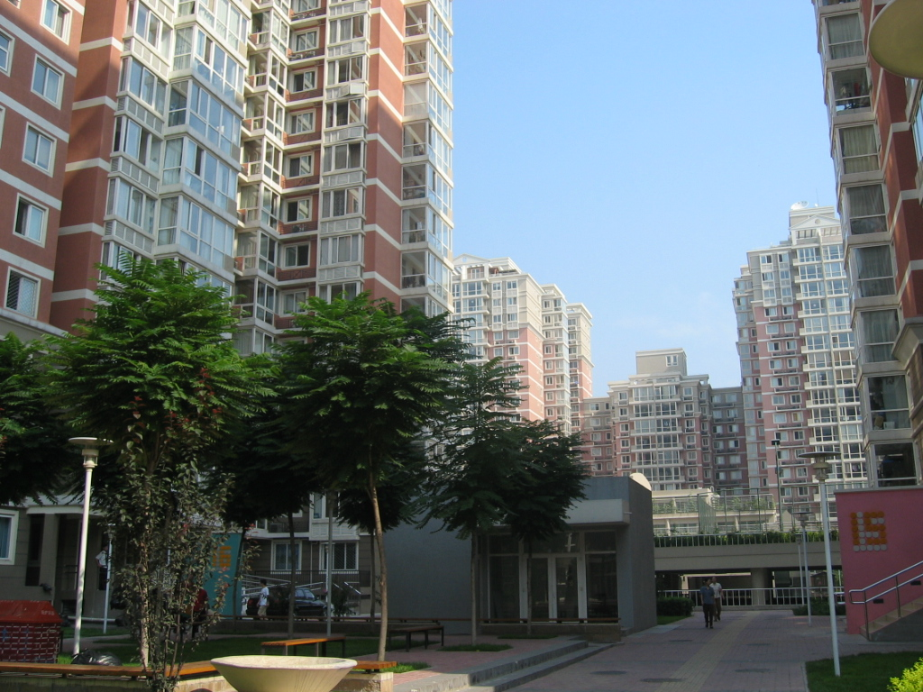
To enumerate, it would help to have a floor plan. Otherwise, the enumerator has to count windows and make assumptions.

Slide 19
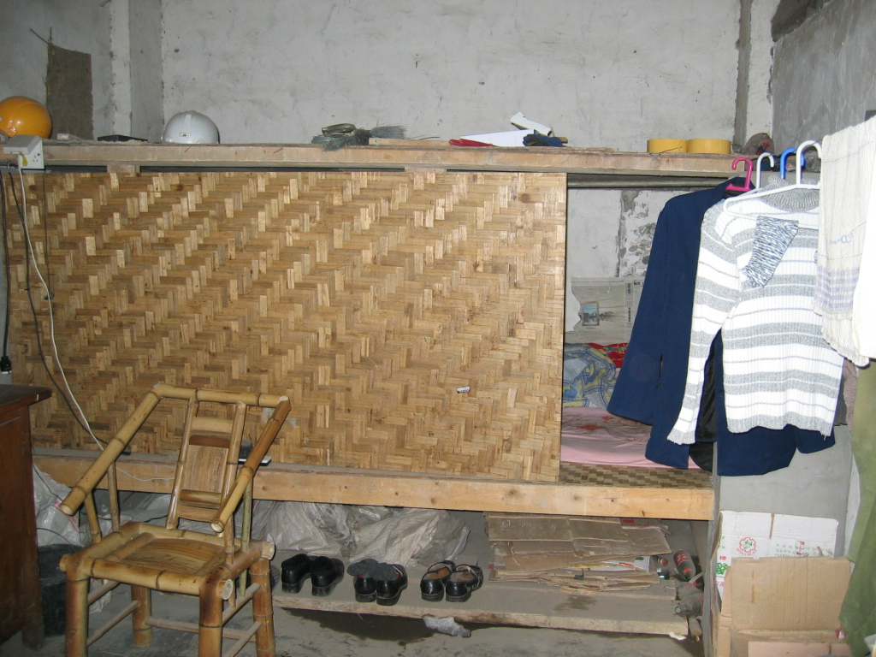
Dormitory space at a construction site.

Slide 20
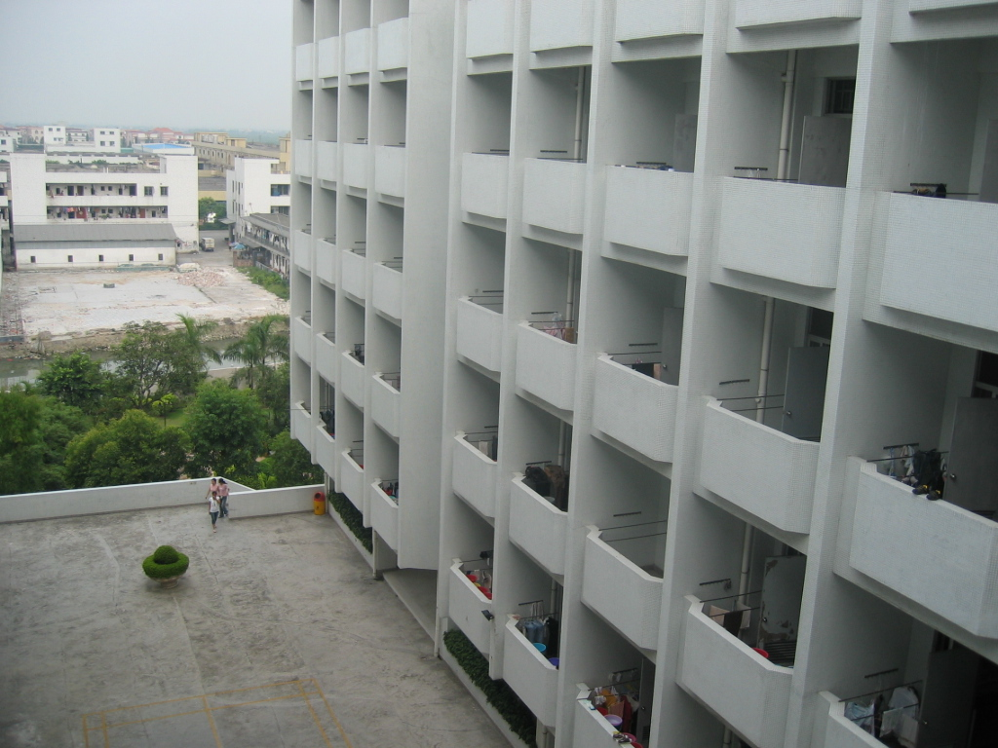
Girls’ dormitory in large toy factory.

Slide 21
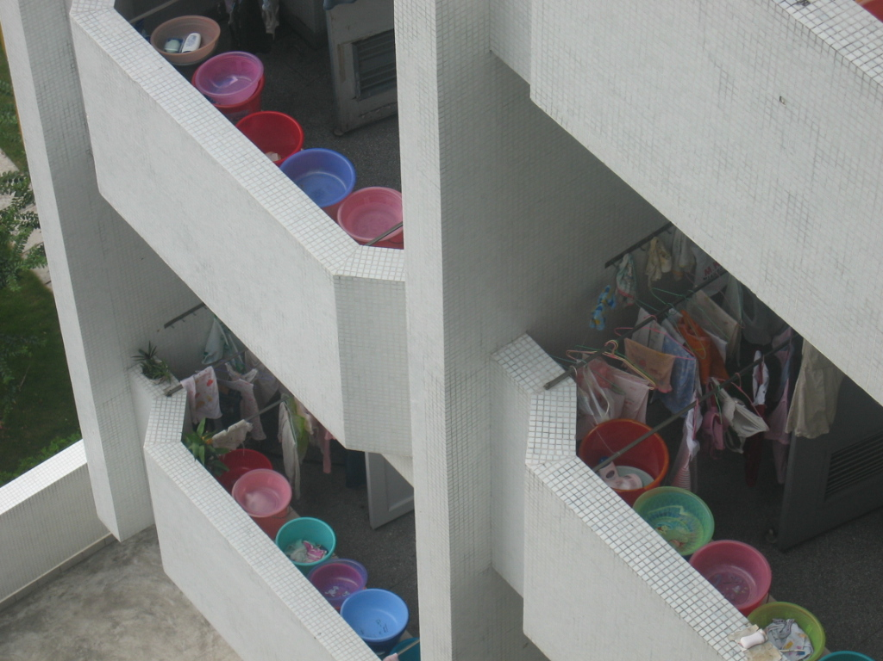
Same dormitory. Clearly there are five girls to a room.

