Slide 1

Internal Migration in China
Donald J. Treiman, UCLA
Conference on Socio-economic Development in China in an International Comparative Perspective
Manchester University, 3-4 Oct. 2017

Slide 2
Outline
Introduction: brief history of migration in China.
Data: the 2008 survey “Internal Migration and Health in China,” a national sample with an over-sample of high out- and in-migration areas (N = 3,000).
Analysis
  Focus on peasant labor migration:
  Determinants of migration (hazard rate models).
  Dynamics of migration (descriptive statistics).
  Short-term consequences—while out (propensity score adjustments).
  Long-term consequences—after return home (fixed effects models).

Slide 3
The hukou system
China built an urban welfare state on the backs of the peasants.
In 1955 established an internal registration (“hukou”) system.
  Overarching agricultural vs. non-agricultural (“rural” vs. “urban”) status, acquired from mother and very difficult to change (Wu and Treiman 2004).
  Local vs. non-local status—crucial for social services.

Slide 4
Hukou system (2)
Many services restricted to those with local registration, or require high non-resident fees. Example: education in Beijing (with some recent changes). Also, health care. Until recently, housing and jobs connected to danwei (work unit).
Separate welfare provisions for rural and urban populations; inferior or non-existent for rural population: food, when rationed; health care; housing; education; unemployment, disability, and retirement benefits.

Slide 5
Contrast between local and migrant schools in Beijing, 2011

Slide 6
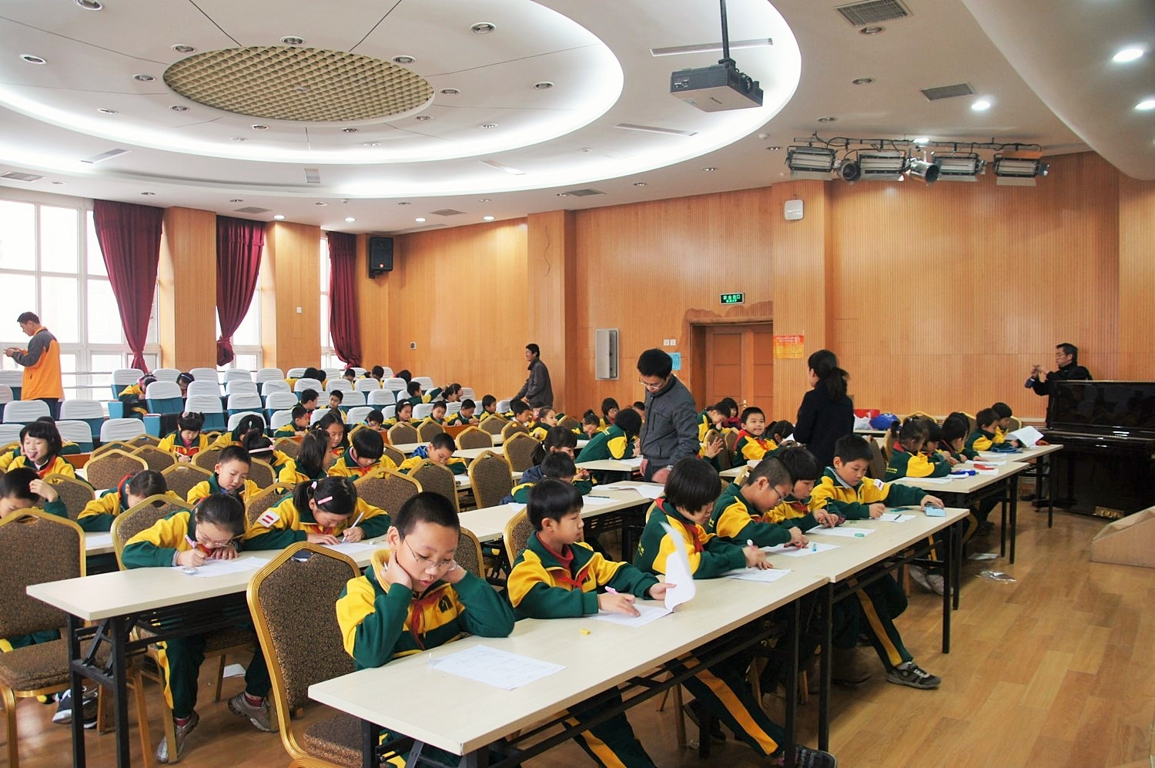

Slide 7
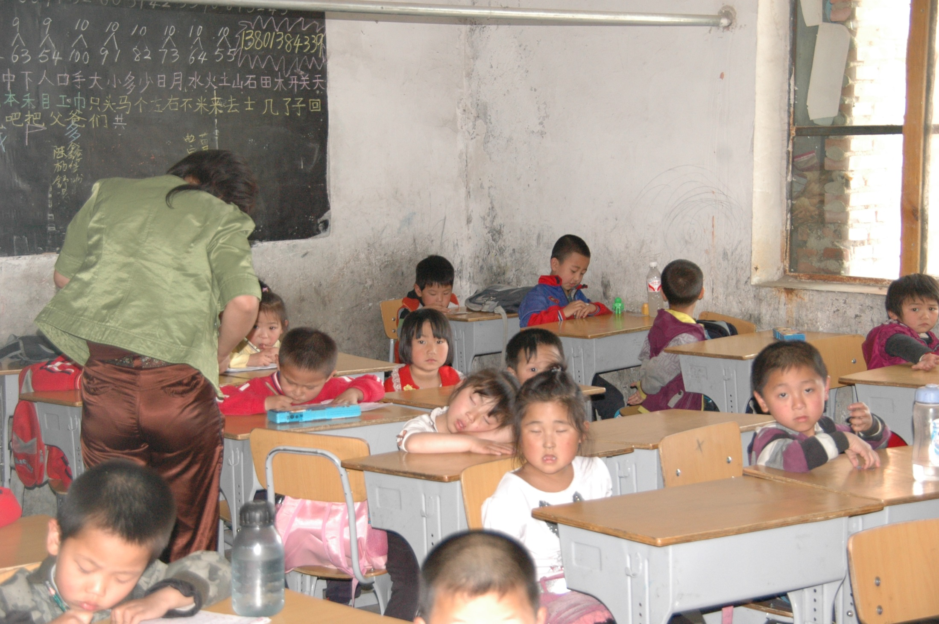

Slide 8
Migration trends
Severe restrictions on migration from 1961-1978 (end of Great Leap Forward to beginning of Economic Reform) [hotel room example].
Increasing migration since then, due to
  Push: “family responsibility system,” resulting agricultural labor surplus.
  Pull: economic expansion in urban areas, e.g., Guangdong, resulting in need for low-level labor (export-oriented manufacturing, construction, service, and sales). Will show occupational distribution later.

Slide 9
Current migration rates
As of 2010, 221 million people lived other than where they were registered, 17% of the Chinese population (Liang, Li, and Ma 2014).
Among adults, the percentage is about the same: in our 2008 data, 16% of people age 18-64 lack local hukou (18% of men and 14% of women).
Migration is complex—both the process and the way it is measured.

Slide 10
1. Hukou and residential mobility between age 14 and date of survey
Nearly half urban (46%): cities and towns vs. villages.
But more than 3/4ths rural at age 14; thus, much rural-to-urban movement. Specifically
  More than half (53%) of the urban pop. has rural hukou.
  Another 17% are rural-to-urban hukou converters.
  Only 30% of urban pop. has urban hukou origin.
In sum, Chinese cities mostly consist of people from the countryside. This is little appreciated.

Slide 12
Two rural-to-urban paths
Labor migration—the “floating population.”
Hukou conversion (13% of rural origin pop.; becomes 35% of “permanent” urban pop.)
  Mainly via education (technical upper middle graduation or tertiary matriculation);
    Entails gamble for bright peasant youth
  Also military service;
  Sometimes due to occupations in demand;
  Educational basis means most individual conversion occurs when young (see slide 13);
  Collective conversion (about 15% of conversions).

Slide 13
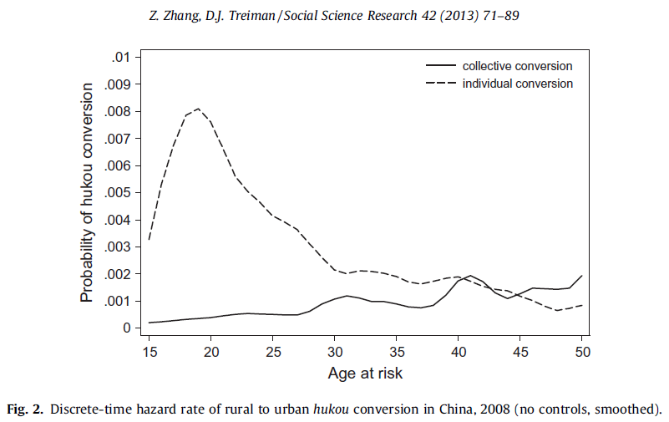
1
/

Slide 14
Methodological aside
Urban samples are inappropriate for any study that considers socioeconomic outcomes.
They effectively sample on the dependent variable.
The 35% of the “permanent” urban population (that is, those with urban hukou) who have converted their hukou are highly positively selected, mainly via education, thus creating very substantial sample selection bias.

Slide 15
Focus of today’s presentation
Today I focus on “peasant labor migration,” that is, “going out for work” by those from rural origins—rural hukou at age 14.
This is 95% of all migration. The remaining 5% are those with urban hukou at age 14.
This unbalance is mainly because 85% of our sample had rural hukou at age 14 (Table 1).
  28% of rural hukou holders ever went out.
  8% of urban hukou holders ever went out.

Slide 16
2. Determinants
What increases the odds that peasants go out for work? (Discrete-time hazard rate models for men & women 14-58 with rural hukou at age 14 and at the age at risk—no covariates except age.)
Expectations:
  As elsewhere, migrants are disproportionately male, young, and unmarried.
  Migrants tend to go out directly from school, rather than from employment.
  “Healthy migrant hypothesis”—migrants are positively selected for health.

Slide 17
2. Determinants (continued)
Expectations (continued):
  Out-migration is disproportionately from low income areas—we have no data to test this.
  Within villages, people from better-off families more likely to migrate—our only test is parental education.
  Family risk diversification hypothesis—large families will keep some members home, send some out.

Slide 24
Summary 2
Likelihood of going out
  Concentrated in the young, especially men.
  Greater in the unmarried, but not significantly for women.
  No effect of family structure (contra the “risk diversification” hypothesis).
  Greatest among those with lower middle education.
  Reduced by employment—many go straight from lower middle school.
  Higher among those with better educated parents.

Slide 25
Summary 2 (continued)
Likelihood of going out
  Increased by health (excellent eyesight, hearing, animal protein as child, greater height relative to others in village—support for “healthy migrant” hypothesis).
  Increased by extreme isolation of village, but only for men.

Slide 26
3. Dynamics
How is migration organized? (description of the experience the first time out of those who have ever gone out for work, among those with rural hukou at age 14).
Expectations:
  “Floating population” is a misleading description; going out for work is well organized, with jobs and places to stay lined up in advance, frequent contact with families.
  Job possibilities are limited.

Slide 27
Migrant workers in “village” between Hangzhou and Shanghai,
2007

Slide 28
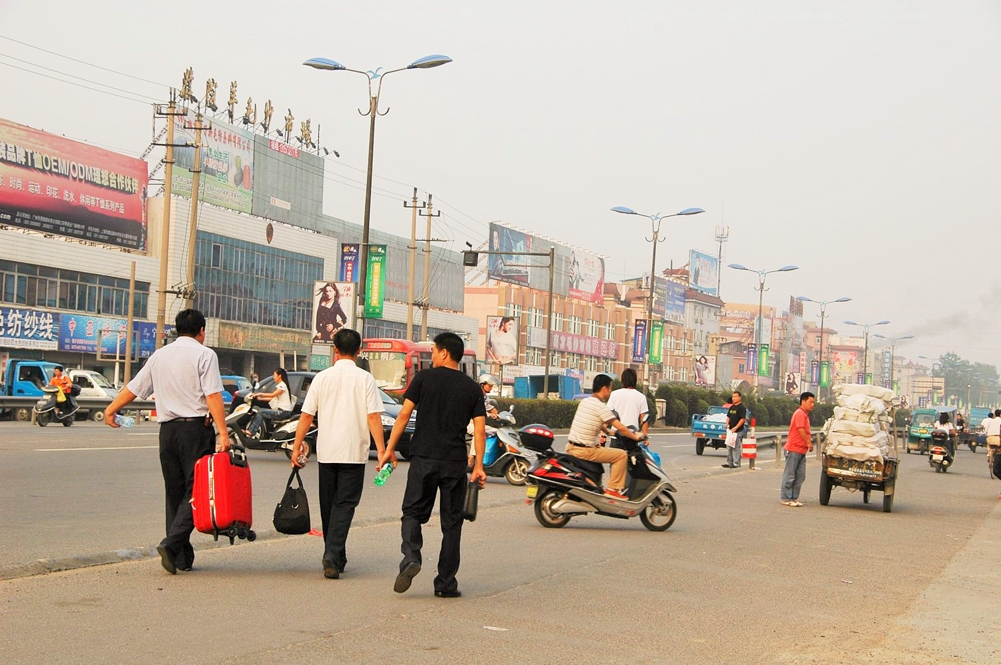

Slide 36
Summary 3
Confirmation that people go out for work when they are very young:
  More than a quarter of men and more than a third of women before they are 18;
  Nearly half between 18 and 29.
Nearly two-thirds go out before marrying.
Migration is usually long distance:
  almost all to a different county;
  about half to a different province.

Slide 37
Summary 3 (continued)
“Floating population” is a misnomer:
  More than half had a job lined up in advance;
  Nearly 60% of men and nearly 80% of women had a place to stay arranged in advance;
  About 75% of men and nearly 90% of women contacted their family at least once per month;
  70% of men and 62% of women went to their home village a least once per year (some women went to their husbands’ families?).
  44% of men and 60% of women sent remittances home at least once a year.

Slide 38
Summary 3 (continued)
Migrants work at a very limited number of jobs.
  More than 2/3rds of men work in just 11 3-digit census categories, plus unreported, out of 435 categories.
  These are mostly construction, factory, and laboring jobs.
  Nearly 3/4ths of women work in just 14 categories, out of 435.
  These are mostly sales, garment manufacturing, assembly, building caretaking, and agric. Jobs.

Slide 39
4: Short-term consequences
What are the consequences of migration? (contrasting current rural migrants with rural-hukou holders who have never migrated, adjusting for sample selection bias using propensity scores).
Expectations: Migration has
  a positive effect on income.
  a negative effect on working conditions.
  a negative effect on quality of life.
  a negative effect on emotional health.
  expected effects on health are unclear.

Slide 40
Sleeping arrangements of some migrant workers
Factory dormitory, Dongguan, Guangdong, 2010.
Construction workers, Beijing, 2007.
Construction worker sleeping in unfinished building, Beijing, 1995.

Slide 41
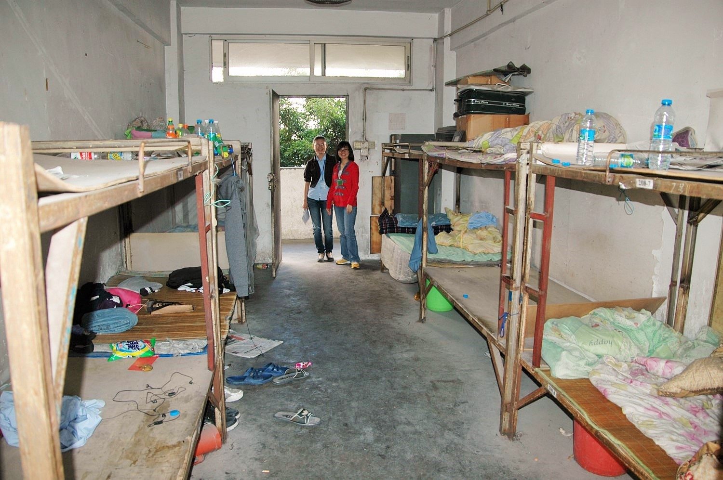

Slide 42
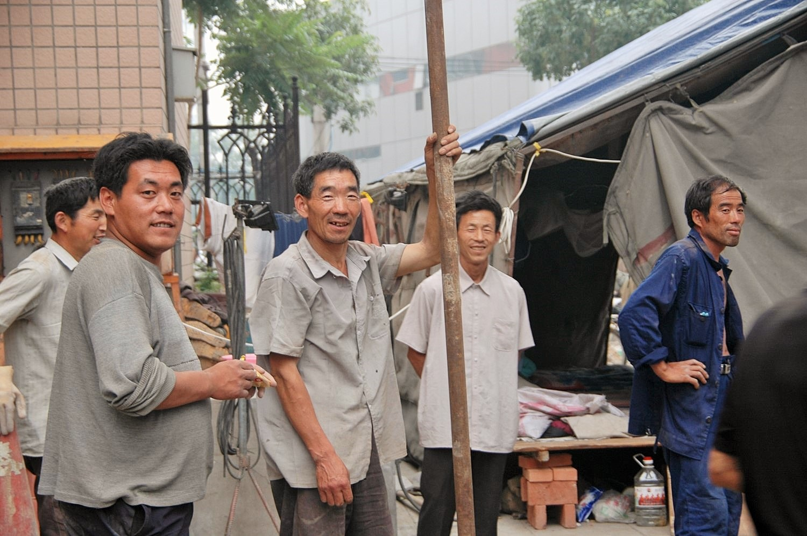

Slide 43
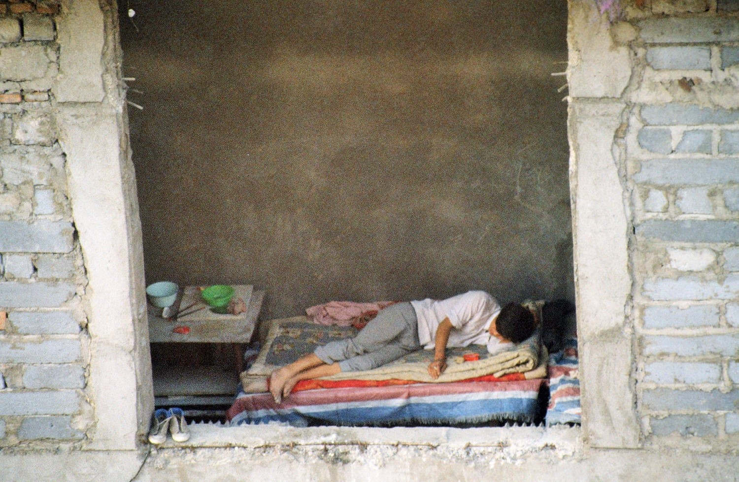

Slide 44
Propensity score model
Adjusts for differences between those who never have gone out, those currently out in
  prevalence of illnesses, gender, and their interaction; years of schooling; age, age-squared, and their interaction with schooling; and size of place of residence prior to going out (dummies).
Nearest neighbor matching with a caliper of .01 and common support.
Reasonably well balanced:
  Mean bias is 5.11% after matching.
  12 of 16 variables have < 5% bias, 3 have < 10% bias, and 1 has > 10% bias.

Slide 50
Summary 4
Results are generally as expected.
  Migration dramatically increases income (86%).
  Migrants have harsher working conditions than rural non-migrants (a striking result).
  Migrants feel disrespected, less happy.
  Migrants more likely to be robbed.
  Migrants less likely to have medical insurance, but more likely to have seen a doctor; eat better; practice better hygiene.
  Migrants less likely to have insomnia (fatigue?)
  No difference in self-reported health.

Slide 51
5: Long-term consequences
What are the consequences of migration for occupational status, level of living? (Over-time fixed-effects analysis for those with rural hukou who had never migrated as of 5 years earlier.)
Contrasts: never out; former (out and back in past 5 years); currently out.
Expectations:
  Current migrants will have higher occupational status (ISEI) and be less likely to work in agriculture than never migrants. The more interesting question—what about former migrants?
  Former migrants will have more consumer durables than never migrants, but current migrants will not, due to restricted living conditions.

Slide 53
Summary 5
Results are mixed but generally as expected.
  Current migrants tend to work at slightly higher status jobs than never or former migrants.
  More interestingly, returned migrants gain no advantage in terms of avoiding agriculture or upgrading their occupational status relative to those who have never migrated.
  But migration pays off in terms of an improved level of living, as measured by the number of consumer durables possessed by returned migrants.

Slide 54
Conclusions
Internal migration in China largely follows the pattern of labor migration elsewhere:
  Migration is selective of the young, especially young men, and of the healthy.
  People typically, but not entirely, go out directly from middle school, w/o previous employment and prior to marriage.
  Even controlling for selectivity, migration appears to be economically advantageous, yielding much higher income than for those left behind and a higher level of living for returned migrants.
  But migration is also costly, resulting in difficult working and living conditions and psychological stress.

Slide 55
Thank you

